Slide 1
SuperStore Sales Dashboard
Task 4 – Dashboard Design
Data Analyst Internship Project

Slide 2
Objective
• Create an interactive dashboard using Power BI
• Analyze sales, profit, segment, category, and regional performance
• Provide insights for business decision-making

Slide 3
Dataset Overview
Dataset: SuperStore Sales Dataset
Contains:
• Orders, Sales, Profit
• Ship Mode, Segment, Category, Sub-category
• Customer and Region-level attributes

Slide 4
Key KPIs
• Total Sales: 1.57M
• Total Profit: 175K
• Total Orders: 22K
• Ship Days: 4

Slide 5
Dashboard Components
Your dashboard includes:
• Donut charts for Payment Mode, Segment
• Bar charts for Sub-Category, Category, Ship Mode
• Time-series charts for Monthly Sales & Monthly Profit
• Map visualization for Sales & Profit by State
• Region slicers for interactivity

Slide 6
Key Insights
• West Region shows highest contribution
• COD is the most used payment mode
• Sales grow significantly in November–December
• Technology category performs strongly
• Consumer segment contributes the largest share

Slide 7
Conclusion
The dashboard provides an interactive and insightful view of business performance, helping stakeholders make data-driven decisions effectively.

Slide 8
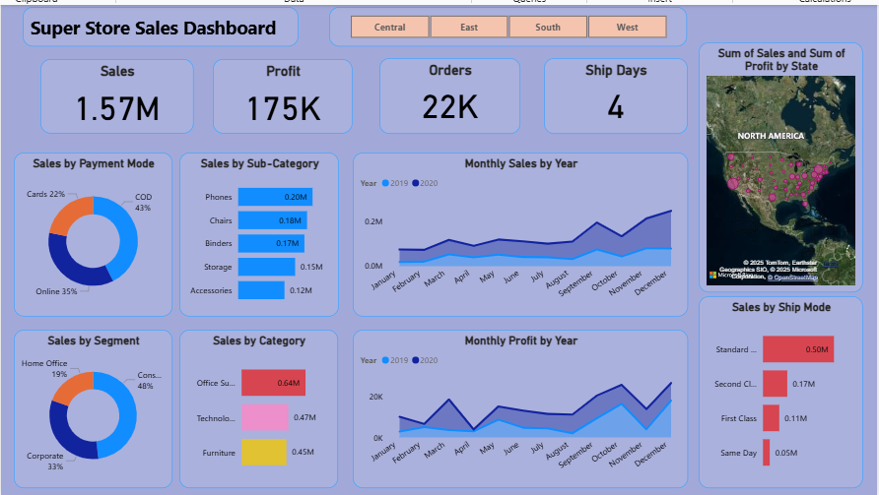
Screenshot of Dashboard

